Slide 1


Maths
Fractions
Year One
Maths | Year 4 | Fractions | Decimal Equivalents for Tenths and Hundredths | Lesson 1 of 1: Tenths and Hundredths

Slide 2
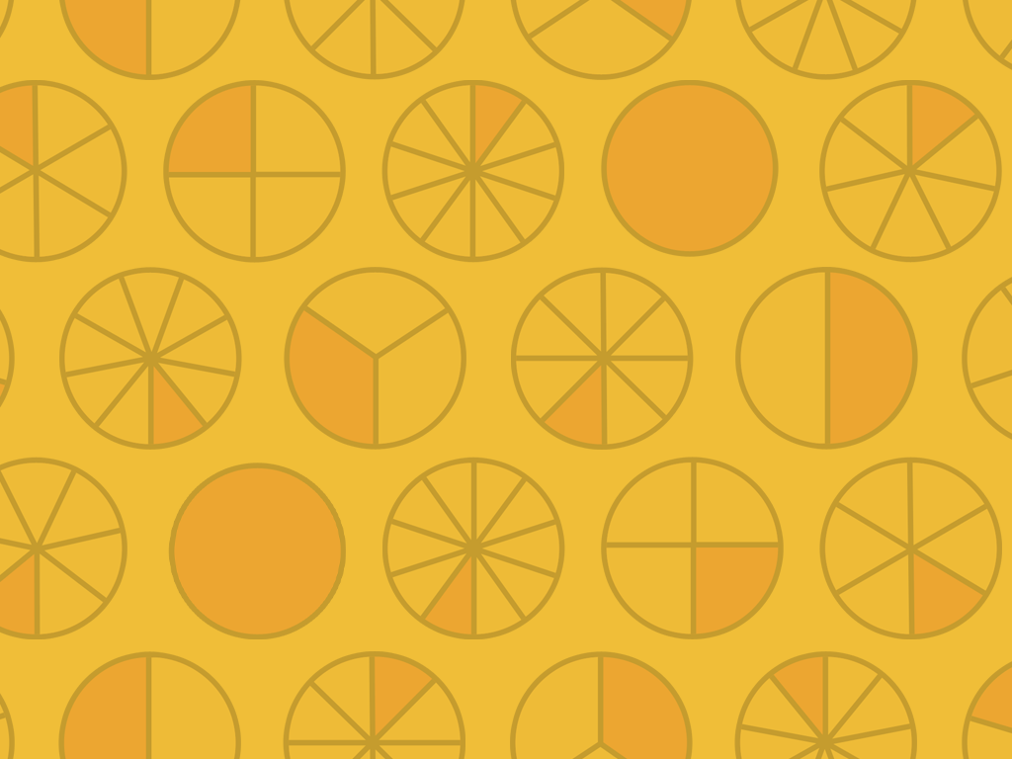

Tenths and Hundredths

Slide 3
Aim
I can recognise decimal equivalents for tenths and hundredths.
Success Criteria
I can recognise decimal equivalents for tenths.
I can recognise decimal equivalents for hundredths.

Slide 4

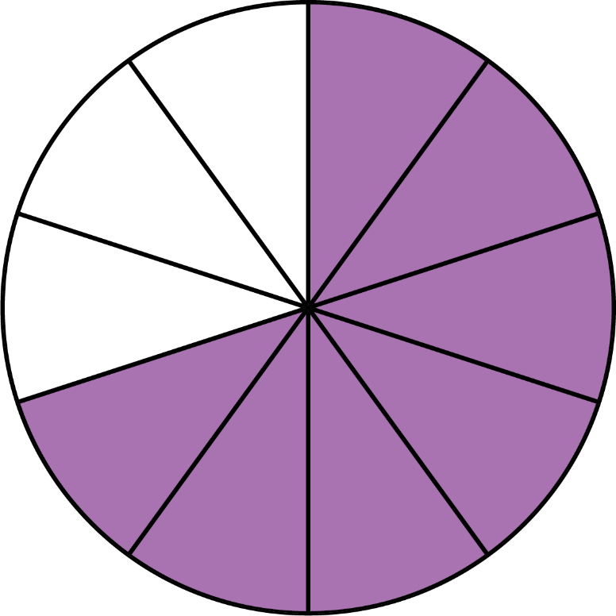

Tenths and Hundredths
What fraction is represented by…
because the whole circle has been divided into 10 equal pieces and 7 of them are coloured in.

Slide 5
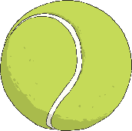

Tenths and Hundredths
What fraction is represented by…
because there are 10 objects, and 5 of them have been selected.

Slide 6
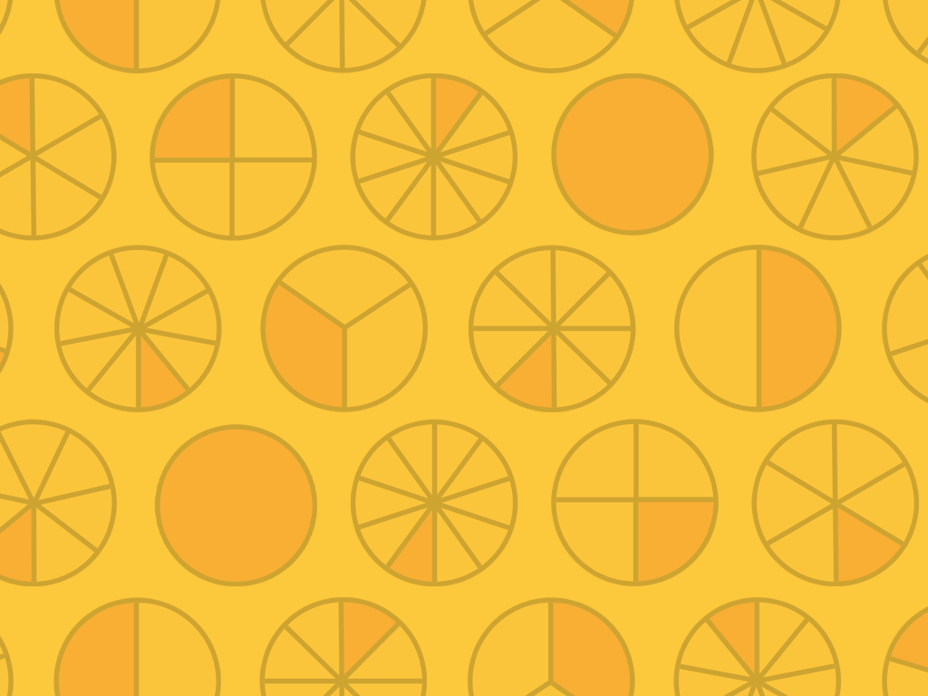

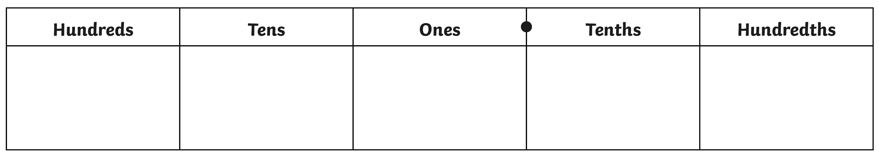
Fractions to Decimals
tenths
hundredths
0
0
0
0
1
3
7
1
9
Place holder
Place holder
Place holder
Place holder
3 tenths
7 tenths
1 tenth
9 tenths

Slide 7

Tenths and Hundredths
What fraction is represented by…
because the whole square has been divided in to 100 equal pieces and 65 of them are coloured in.

Slide 8

Tenths and Hundredths
What fraction is represented by…
because the whole square has been divided in to 100 equal pieces and 40 of them are coloured in.

Slide 9
Fractions to Decimals
tenths
hundredths
0
0
0
0
0
0
4
2
8
Place holders
Place holders
Place holders
4 hundredths
2 hundredths
8 hundredths

Slide 10
Fractions to Decimals
tenths
hundredths
0
1
10

Slide 11
Fractions to Decimals
tenths
hundredths
0
3
30

Slide 12
Fractions to Decimals
tenths
hundredths
0
9
90

Slide 13
Fractions to Decimals
tenths
hundredths
0
6
60

Slide 14
Fractions to Decimals
tenths
hundredths
0
2
5

Slide 15
Fractions to Decimals
tenths
hundredths
0
4
8

Slide 16
Fractions to Decimals
tenths
hundredths
0
7
2

Slide 17
Fractions to Decimals
tenths
hundredths
0
9
1

Slide 18

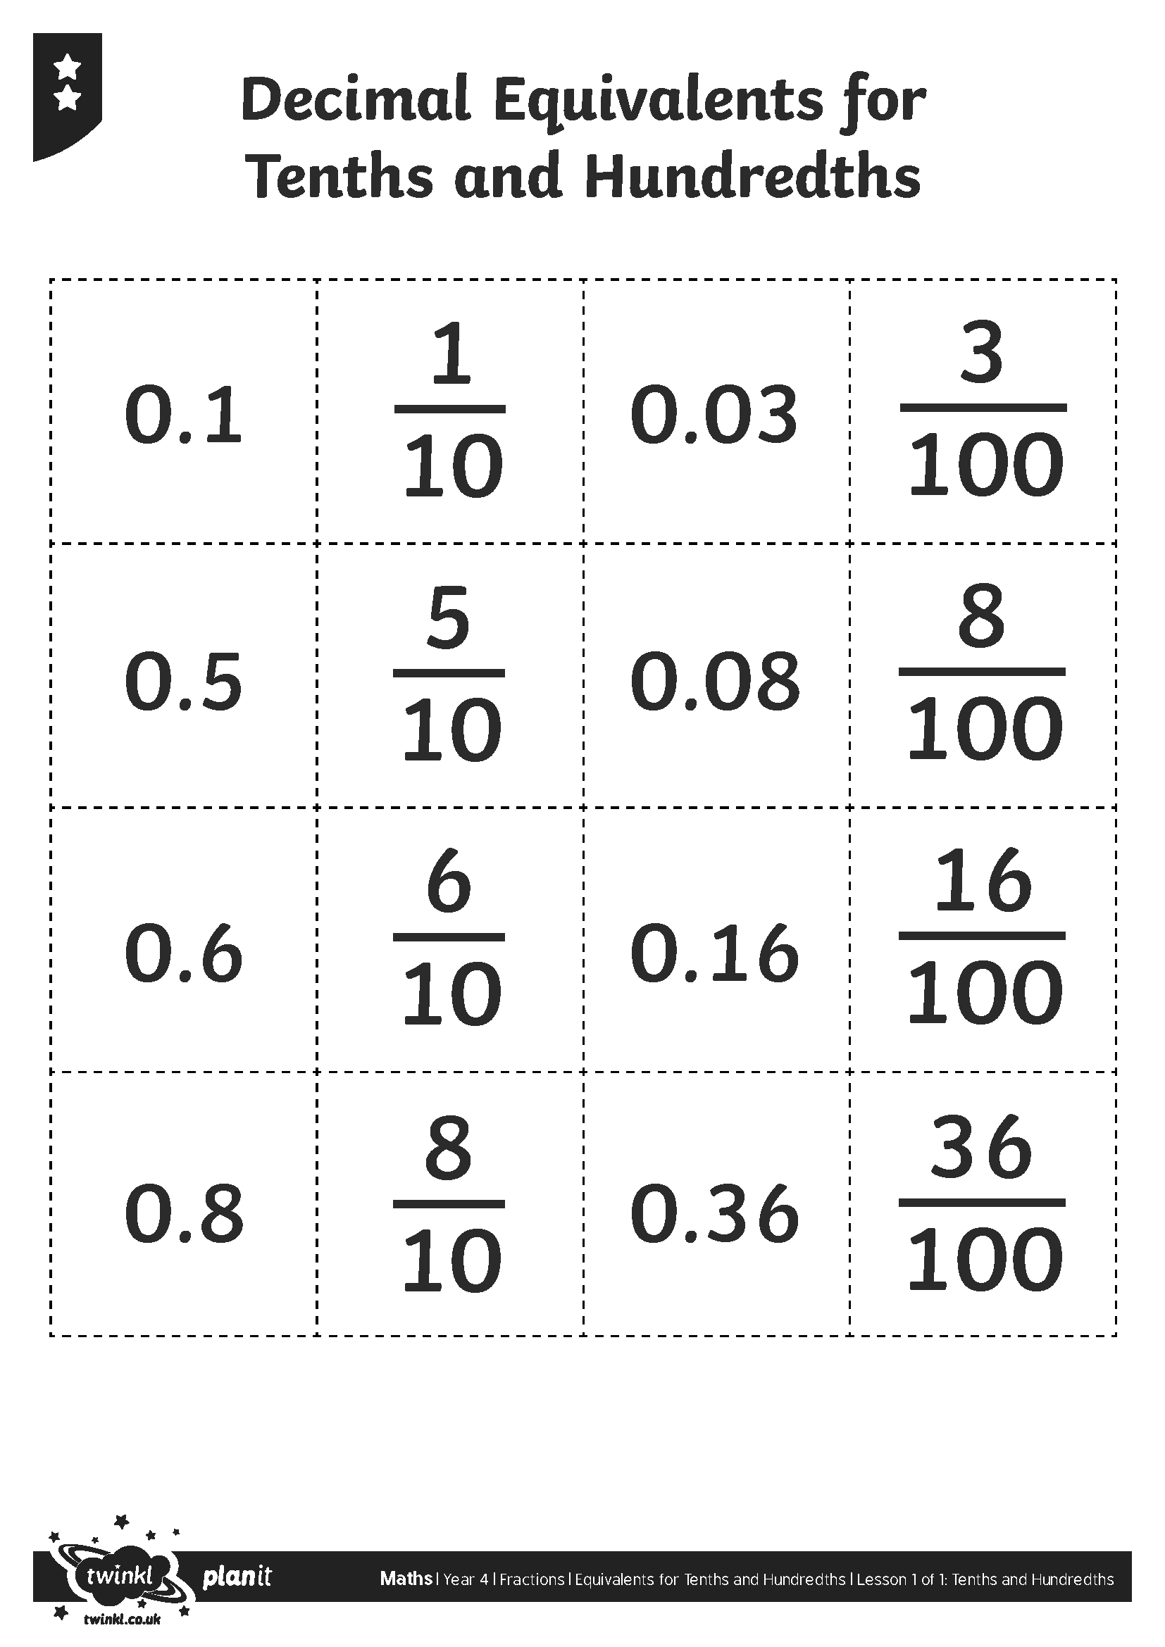
Pairs

Slide 19

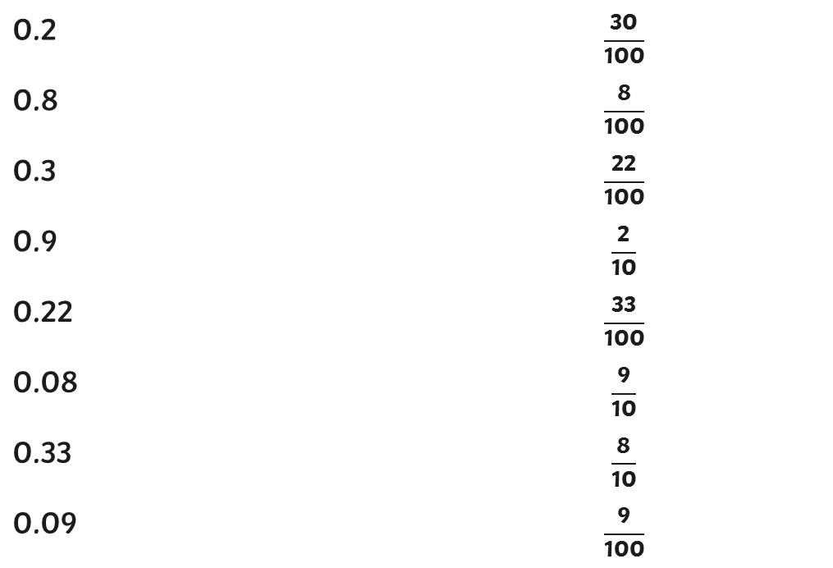
Match It
Match the decimal numbers to the equivalent fractions.
0.2
0.8
0.3
0.9
0.22
0.08
0.33
0.09

Slide 20
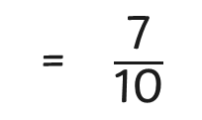
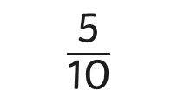


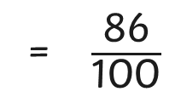
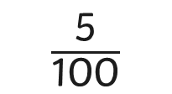
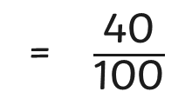
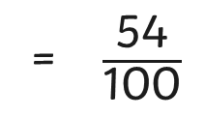
Match It
Complete the equivalent pairs of fractions and decimals.
5
0.7
0.5 =
0.01 =
0.07 =
60
0.86
0.6 =
0.4
0.54

